Slide 1
Automating SAP on Azure
Rick Rainey
Twitter: @RickRaineyTx | Blog: http://rickrainey.com | Email: rickra@microsoft.com
Notes:
Suggested introduction:
Faced with _______
We did _______
And discovered_______

Slide 2
Agenda
Azure Resource Manager (ARM)
Introduction to ARM Templates
Deploying ARM Templates
Authoring ARM Templates
Desired State Configuration (DSC)
WTF!

Slide 3
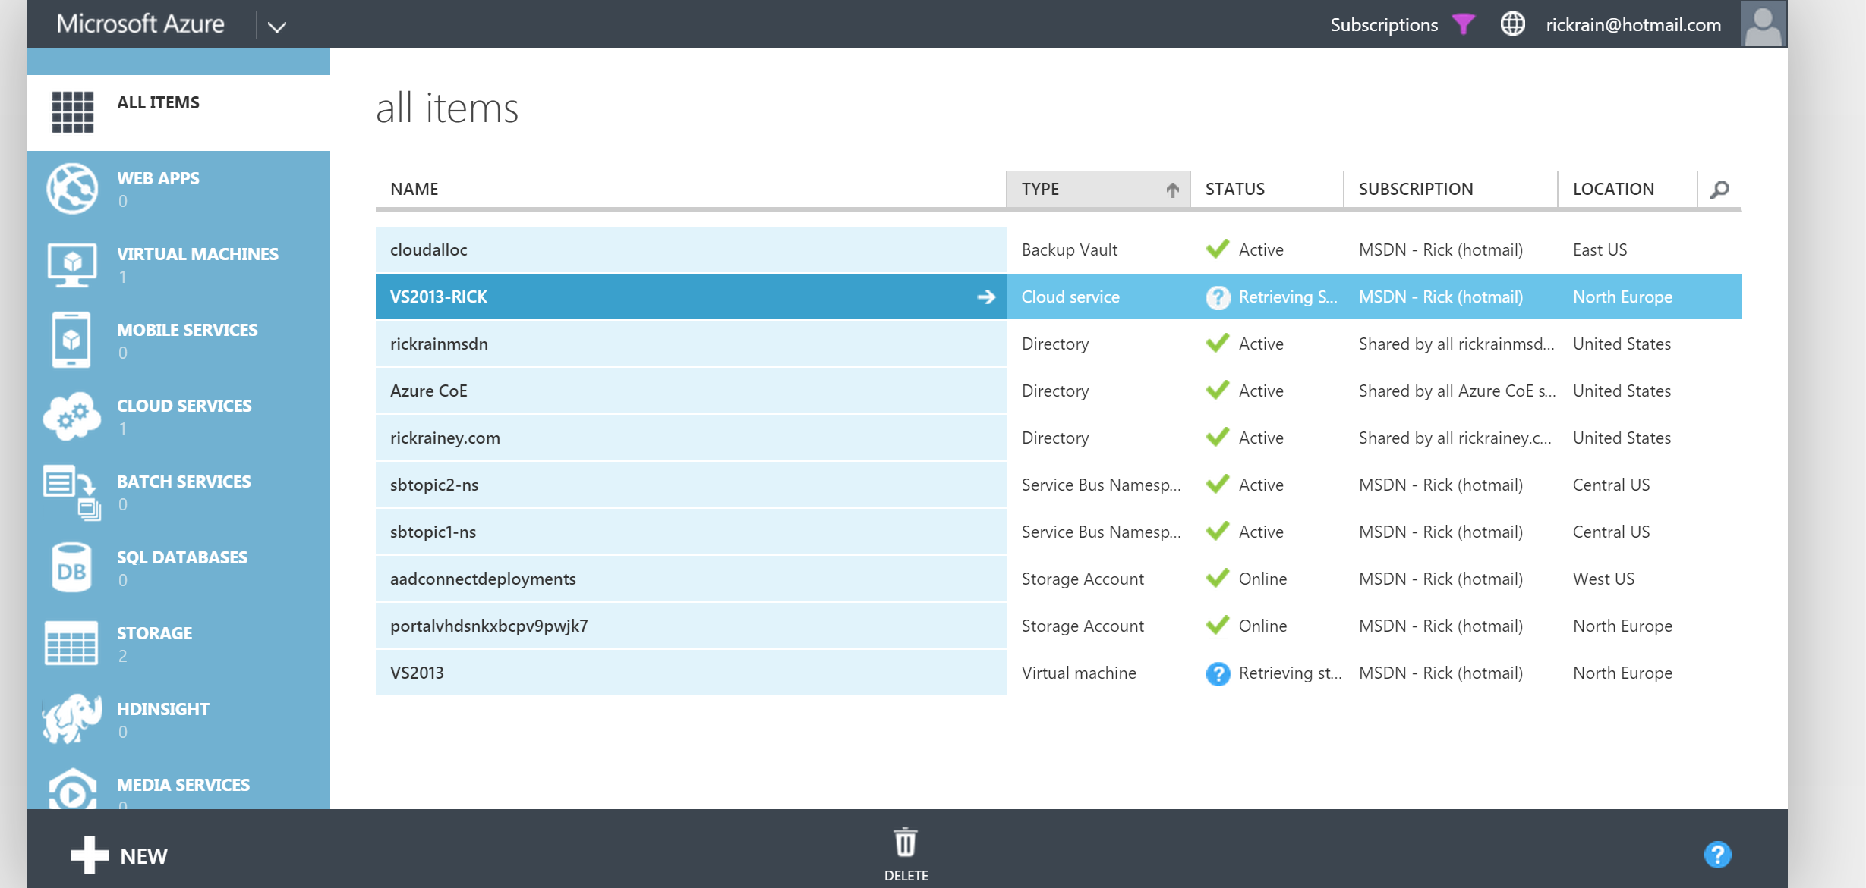
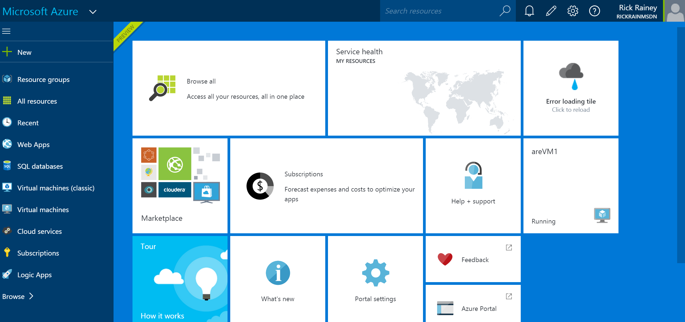
Provisioning Resources in Azure
Azure Service Mgmt (ASM)
Azure Resource Mgr (ARM)
Old
New
Programmatic
Serial resource provisioning
Non-idempotent
Declarative
Parallel resource provisioning
Idempotent

Slide 4










Azure Resource Manager Architecture
Microsoft Azure
ARM Key Takeaways
A resource always belongs to a Resource Group (RG)
RG is a unit of management
Declarative
RBAC support
Custom policies
Azure Subscription
Resource Group
LOB App
Resource Group
IaaS Workload
Resource Providers
Azure Resource Manager (ARM)
REST API Endpoints

Slide 5
Explore Resource of an existing SAP Deployment

Slide 6
Introduction to ARM Templates

Slide 7
What is an ARM Template?
JSON files – “Infrastructure-as-code”
Artifacts (optional depending on resources)
Configuration files to apply to resources
Example:
Desired State Configuration (DSC) Script and DSC Resources

Slide 8
Finding Existing Templates
Azure Quickstart Templates
http://aka.ms/qst
Azure Marketplace via Azure Portal
SQL Server AlwaysOn Cluster
SharePoint 2013 HA Farm
Etc.

Slide 9
Azure Quickstart Templates & Azure Marketplace

Slide 10
Deploying SAP on Azure
Hands-on-Lab

Slide 11
Deployment Pre-Requisites
Hands-on-Lab
REQUIRED
Microsoft Azure Subscription
Computer running Windows 7, 8.1, 10, Server 2012/R2
Azure PowerShell Cmdlets v1.0.3 (or later)
http://aka.ms/webpi-azps
Microsoft Azure Storage Explorer
http://storageexplorer.com/
OPTIONAL
Visual Studio 2015 Community Edition (or higher)
http://aka.ms/vs2015-comm
Azure Tools SDK v2.8.2
http://aka.ms/az-sdk

Slide 12
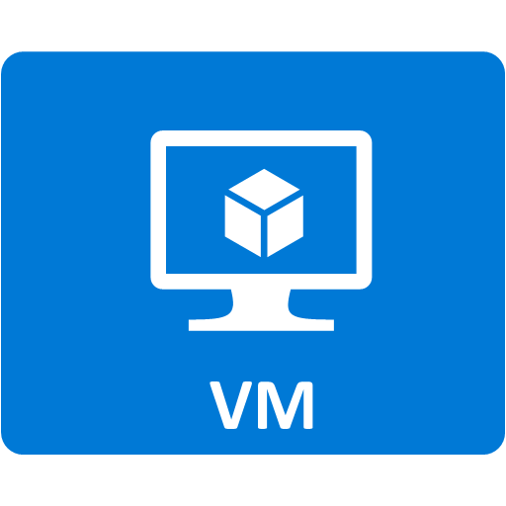

Deployment Architecture
Hands-on-Lab
Your Azure Subscription
MSFT Azure Subscription
SAP-Azure-RG
Storage Account
(East US)
PDC
./sapbits/file.zip
BDC
F:\
SAP
SAS URL
G:\
H:\

Slide 13
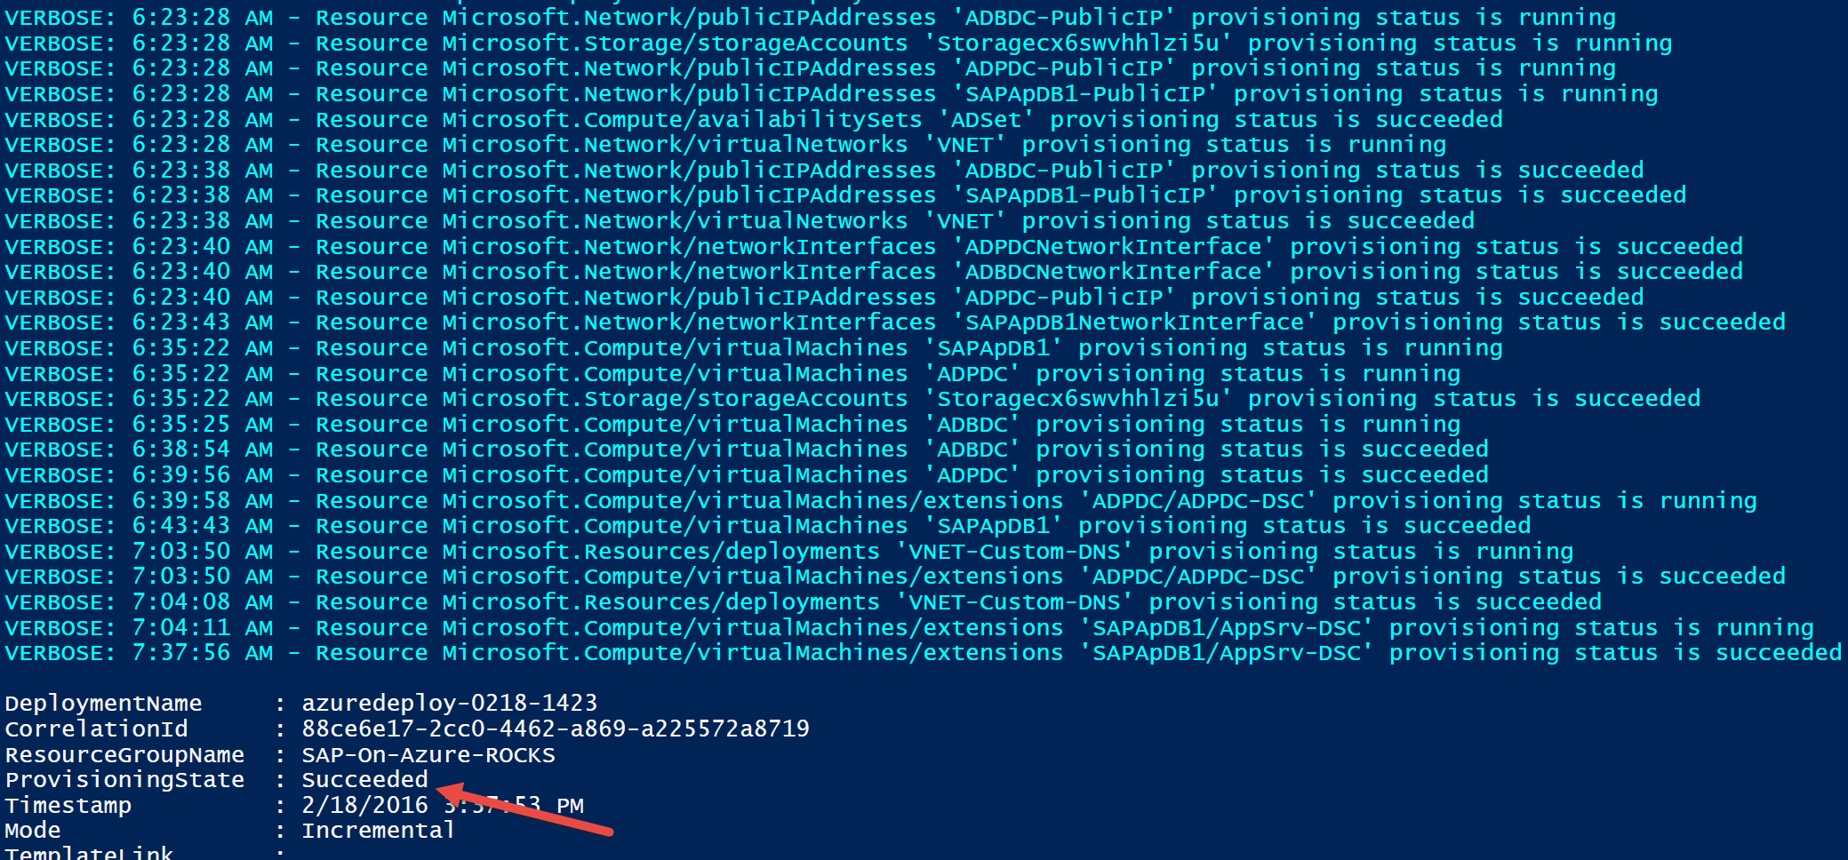
What does deployment success look like?

Slide 14
Get the solution bits! ☺ http://bit.ly/1oubyMK

Slide 15
( and hands-on-lab )
Deploy SAP on Azure

Slide 16
Authoring ARM Templates

Slide 17





Deploying Resources using ARM
Deployment template (JSON)
Deployment template parameters (JSON)
Microsoft Azure
Deployment script (PowerShell)
Azure Subscription
Push Deployment template and parameters to ARM
Resource Group
Resource Group
ARM

Slide 18
Desired State Configuration (DSC)

Slide 19
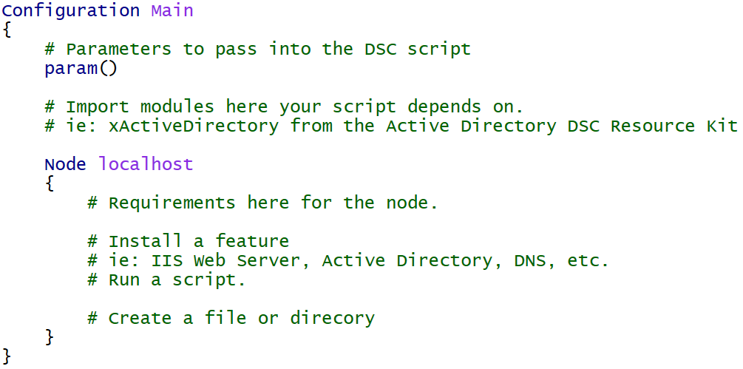
Introducing DSC for Azure
Declarative configuration of the virtual machine
Windows Features and Roles
Custom application configuration

Slide 20
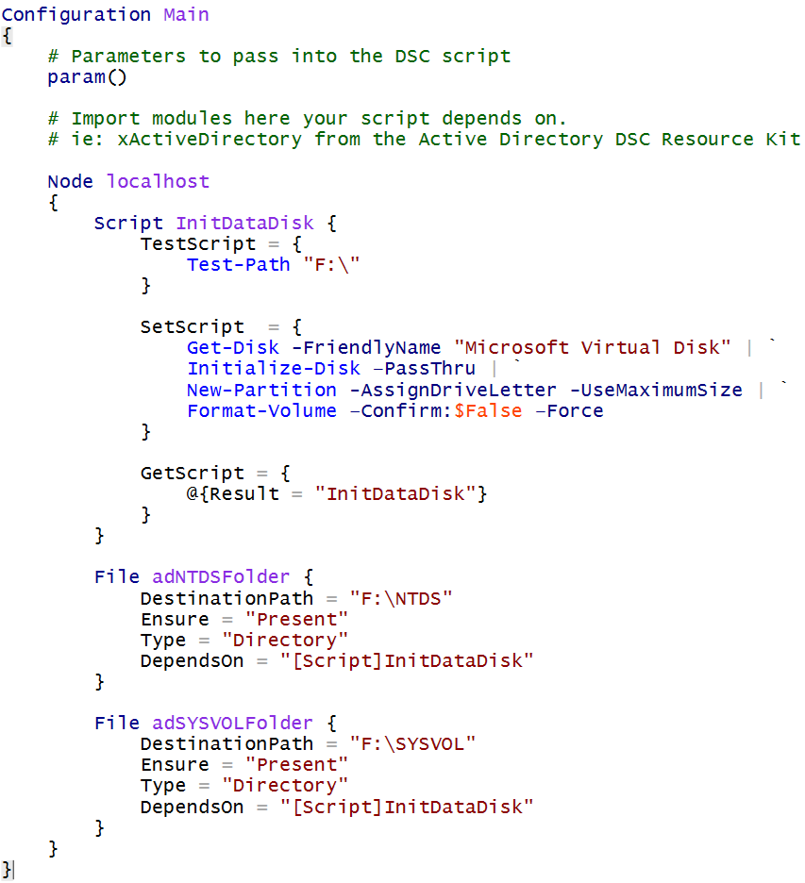
Initialize data disks and create AD folders

Slide 21
DSC Resources
Built-in
WindowsFeature, File, Package, Script
DSC Resource Kit (~500 resources)
https://blogs.msdn.microsoft.com/powershell/2016/02/11/dsc-resource-kit-gets-even-bigger/

Slide 22
DSC log file locations
C:\Packages\Plugins\Microsoft.Powershell.DSC\<version>
C:\WindowsAzure\Logs\Plugins\Microsoft.Powershell.DSC\<version>

Slide 23
When Things Fail (WTF !#%#@)

Slide 24
Deploying from Visual Studio
12:54:20 - [ERROR] New-AzureRmResourceGroupDeployment : ExpiredAuthenticationToken: The access
12:54:20 - [ERROR] token expiry UTC time '2/16/2016 8:54:20 PM' is earlier than current UTC time
12:54:20 - [ERROR] '2/16/2016 8:54:20 PM'.
Background: This is a known issue that will be resolved soon. Visual Studio provides a token to Login-AzureRmAccount during deployment. If the token is aged, then this error may occur in long running deployments.
Azure Tools SDK 2.8.2
Azure PowerShell 1.0.3
Work-around: Deploy using PowerShell

Slide 25
Ask ARM for resource logs
Get-AzureResourceProviderLog -ResourceProvider "Microsoft.Network"
Get-AzureResourceProviderLog -ResourceProvider "Microsoft.Network" `
-Status Failed
Get-AzureResourceProviderLog -ResourceProvider "Microsoft.Network" `
-Status Failed | select EventTimeStamp | Sort EventTimeStamp
Get-AzureResourceProviderLog -ResourceProvider "Microsoft.Network" `
-Status Failed -StartTime "7:20:00 PM" -EndTime "7:22:00 PM" `
-DetailedOutput

Slide 26
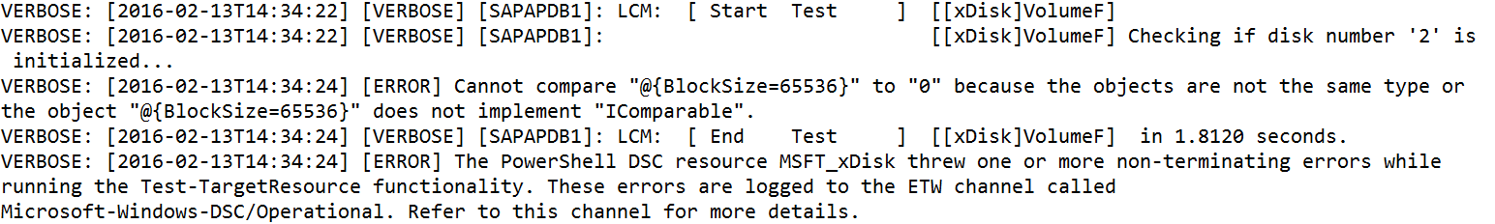
DSC Logs
Provides details on the configuration (script) in the virtual machine
C:\WindowsAzure\Logs\Plugins\Microsoft.Powershell.DSC\<version>

Slide 27
DSC Logs

Slide 28
http://bit.ly/SAPRedmondDay3

